Slide 1
Introduction to Data Science
Dr. N. Subhash Chandra
Professor CSE

Slide 2
UNIT-1: Contents
Data Science, Data Objects and Attributes types
Measuring Data similarity and dissimilarity,
Data Preprocessing -Data Cleaning, Data Integration, Data Reduction, Data Transformation and Data Discretization,
Traits of Big data
Hypothesis and inference, Analysis vs Reporting.
Data Science Toolkits using Python: Matplotlib, NumPy, Scikit-learn. Visualizing Data: Bar Charts, Line Charts, and Scatterplots.
Working with data: Reading Files, Scraping the Web,
Using APIs (Example: Using the Twitter APIs), Cleaning and Munging, Manipulating Data.
Case Study: Getting Data -Twitter Data API

Slide 3
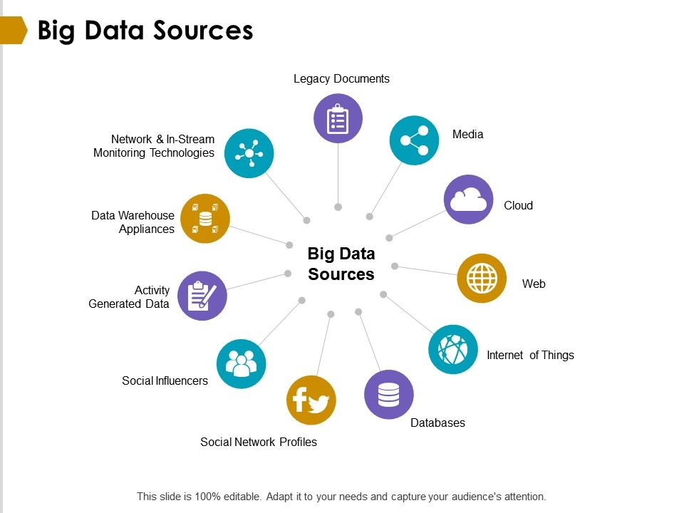
What is BIG DATA?
Big Data is a collection of data that is huge in volume, yet growing exponentially with time.
It is a data with so large size and complexity that none of traditional data management tools can store it or process it efficiently.
Big data is also a data but with huge size.
Refer to various bigdata sources from figure

Slide 4
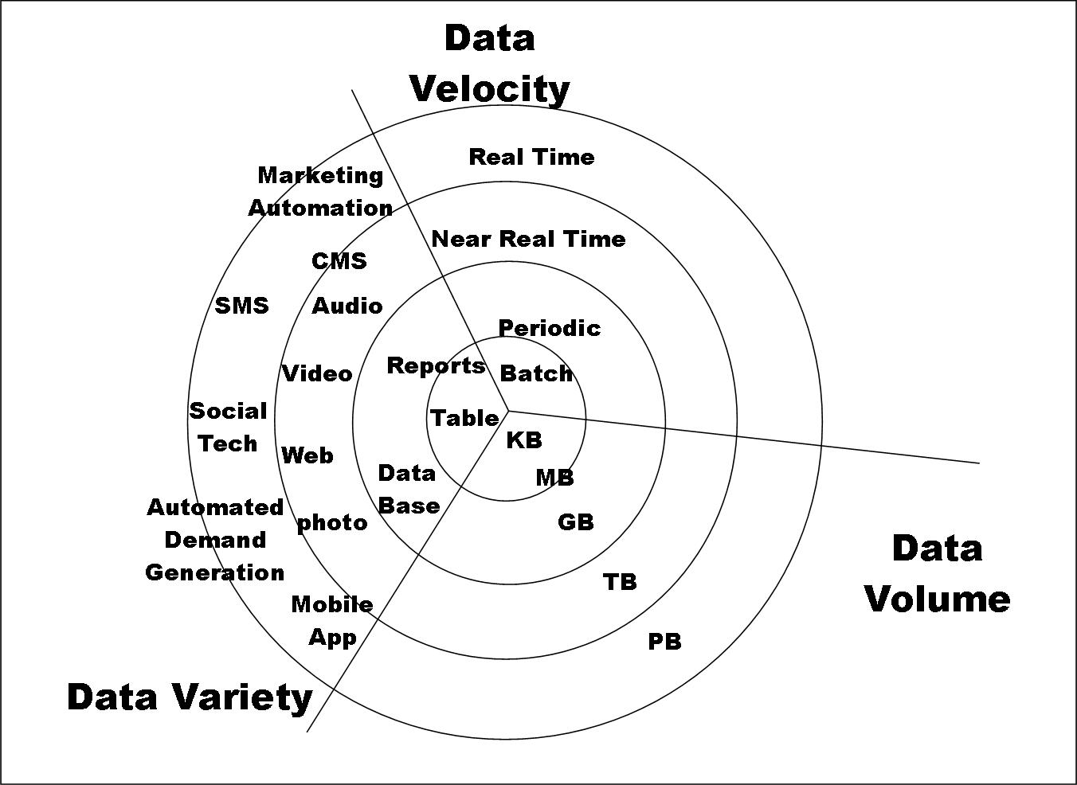
Big Data

Slide 5
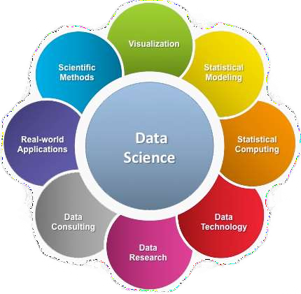
What is Data Science?
A multi-disciplinary field that uses scientific methods, processes, algorithms and systems to extract knowledge and insights from structured and unstructured data.

Slide 6
Advantages and Disadvantages of Data Science
Advantages
It helps us to get insights from the historical data with its powerful tools.
It helps to optimize the business, hire the right persons and generate more revenue as using data science helps you to make better future decisions for the business.
Companies can develop and market their products better as they can better select their target customers.
Introduction to Data Science also helps consumers search for better goods, especially in e-commerce sites based on the data-driven recommendation system.
Disadvantages
The disadvantages are generally when data science is used for customer profiling and infringement of customer privacy, as their information, such as transactions, purchases, and subscriptions, is visible their parent companies. The information obtained using data science can be used against a certain group, individual, country or community.

Slide 7
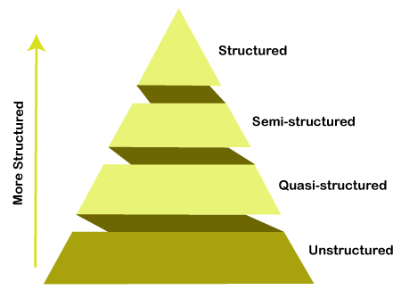
Types Of Big Data:
Structured data: In Structured schema, along with all the required columns. It is in a tabular form. Structured Data is stored in the relational database management system.
Semi-structured: In Semi-structured, the schema is not appropriately defined, e.g., JSON, XML, CSV, TSV, and email. OLTP (Online Transaction Processing) systems are built to work with semi-structured data. It is stored in relations, i.e., tables.
Unstructured Data: All the unstructured files, log files, audio files, and image files are included in the unstructured data. Some organizations have much data available, but they did not know how to derive the value of data since the data is raw.
Quasi-structured Data: The data format contains textual data with inconsistent data formats that are formatted with effort and time with some tools.

Slide 8
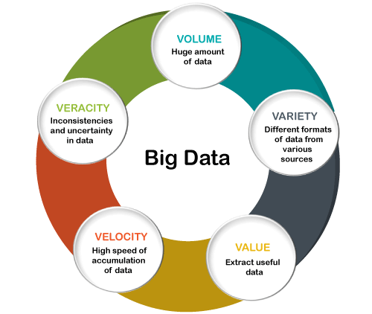
Traits/Characteristics Of Big Data
There are five v's of Big Data that explains the characteristics.
5 V's of Big Data
Volume
Variety
Veracity
Velocity
Value

Slide 9
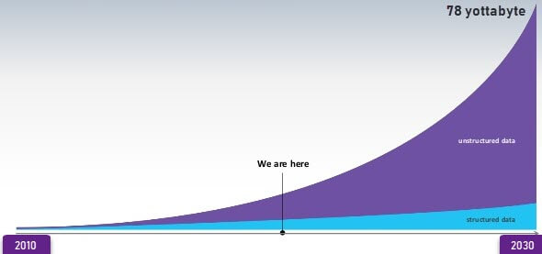
Volume:
The name Big Data itself is related to an enormous size. Big Data is a vast 'volumes' of data generated from many sources daily, such as business processes, machines, social media platforms, networks, human interactions, and many more.
Facebook can generate approximately a billion messages, 4.5 billion times that the "Like" button is recorded, and more than 350 million new posts are uploaded each day. Big data technologies can handle large amounts of data.
DATA GROWTH

Slide 10
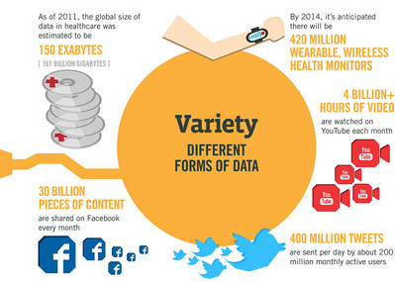
Variety:
Big Data can be structured, unstructured, and semi-structured that are being collected from different sources.
in the past, data is only be collected from databases and sheets
But these days the data will comes in array forms, that are PDFs, Emails, audios, SM posts, photos, videos, etc.

Slide 11
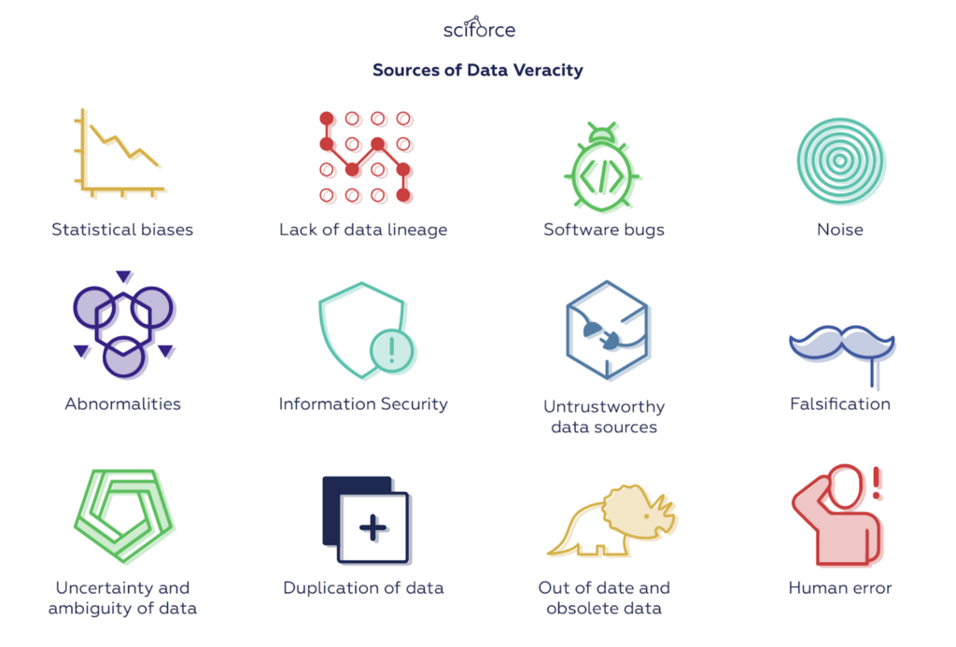
Veracity:
Veracity means how much the data is reliable.
Big Data Veracity refers to the biases, noise and abnormality in data.
Is the data that is being stored, and mined meaningful to the problem being analyzed.
veracity in data analysis is the biggest challenge when compares to things like volume and velocity.

Slide 12
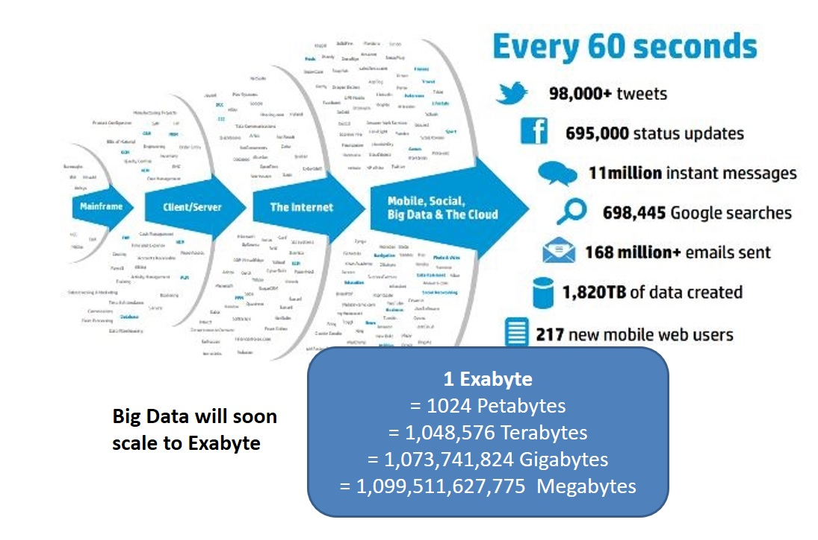
Velocity and value:
Velocity – The term 'velocity' refers to the speed of generation of data. How fast the data is generated and processed to meet the demands, determines real potential in the data.
Big Data Velocity deals with the speed at which data flows in from sources like business processes, application logs, networks, and social media sites, sensors, mobile devices, etc.
The flow of data is massive and continuous.
Value- sits at the top of the big data pyramid.
This refers to the ability to transform a tsunami of data into business.
it is not the data that we process or store.
It is valuable and reliable data that we store, process, and also analyze.

Slide 13
Top Big Data Tools: open source
Hadoop
framework
It allows distributed processing of large data sets across clusters of computers.
Cassandra:
Support for replicating across multiple data centers by providing lower latency for users
CouchDB:
stores data in JSON documents that can be accessed web or query using JavaScript. It offers distributed scaling with fault-tolerant storage. It allows
Openrefine:
It is a big data analytics software that helps to work with messy data, cleaning it and transforming it from one format into another.
It also allows extending it with web services and external data.
Hive:
It helps with querying and managing large datasets real fast.
Many more

Slide 14
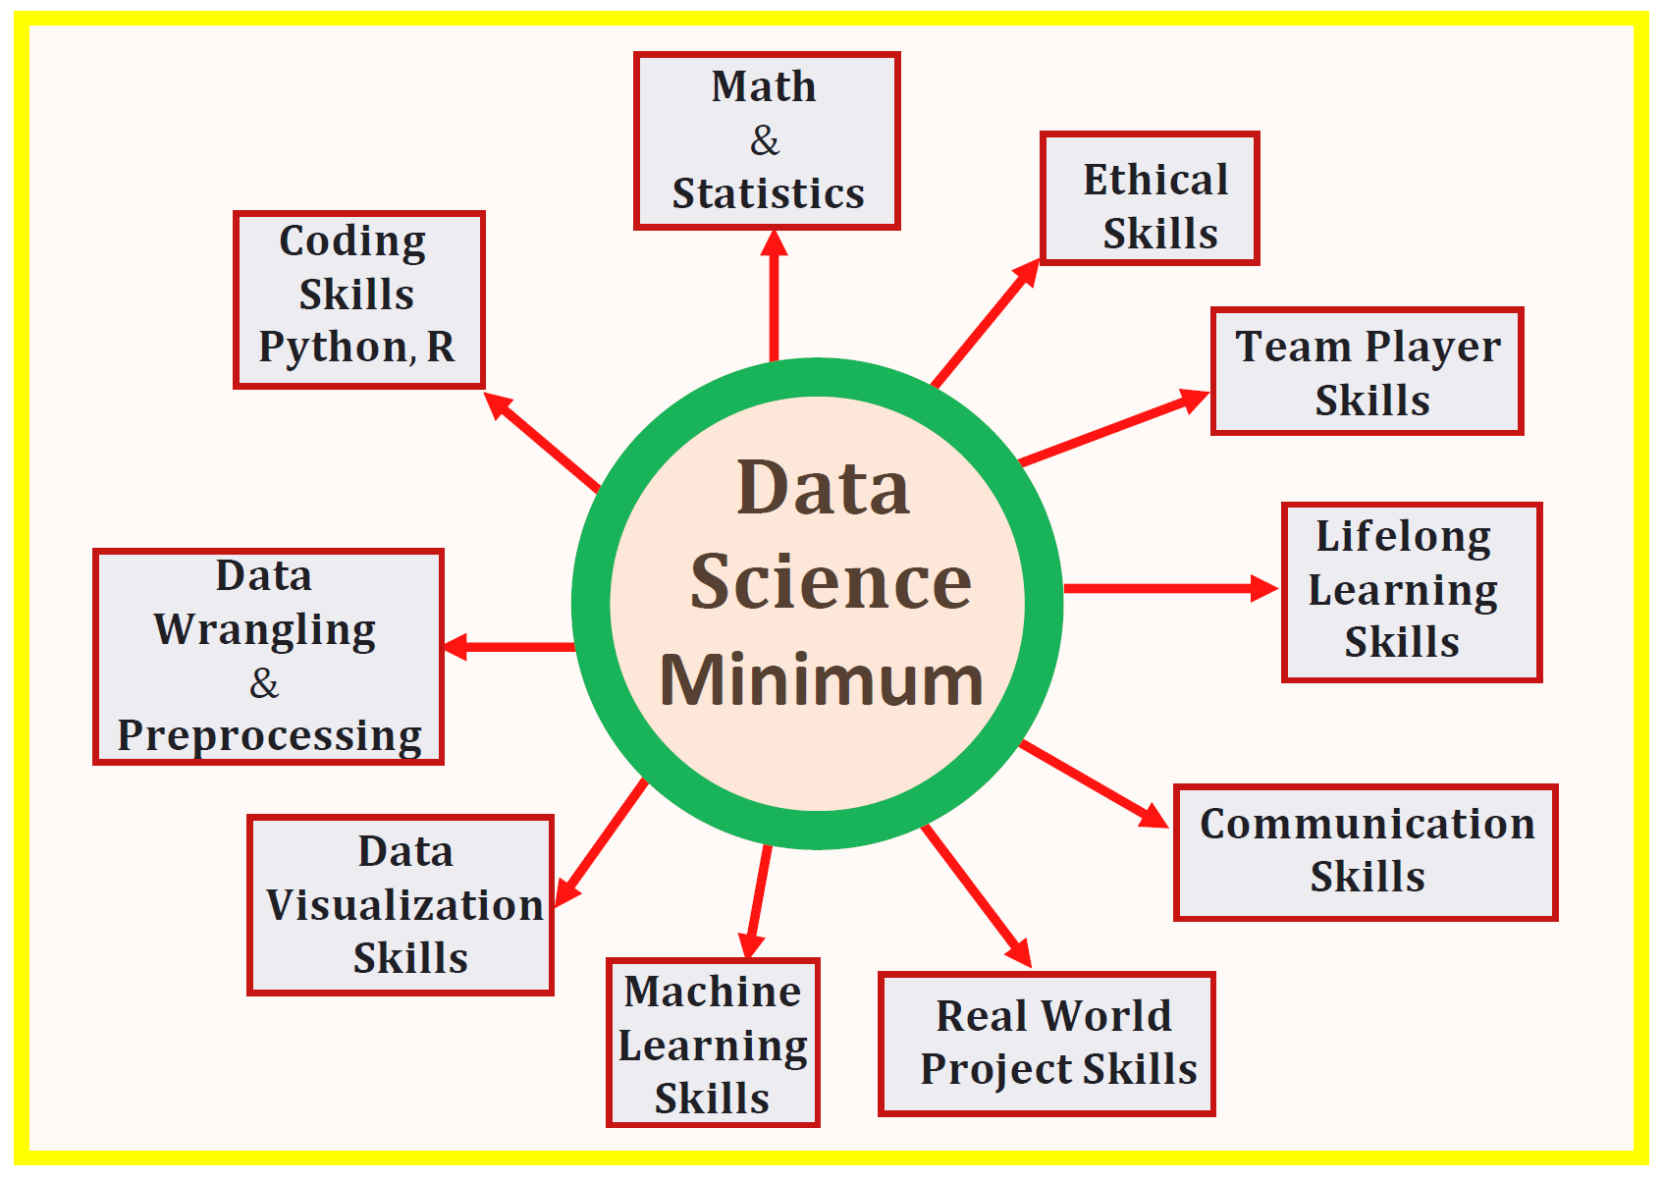

Slide 15
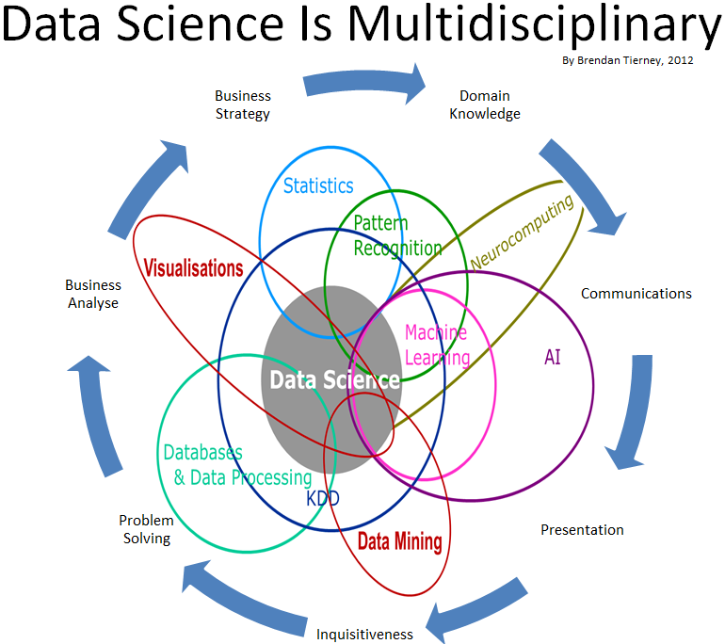
Data Science

Slide 16
